Slide 1

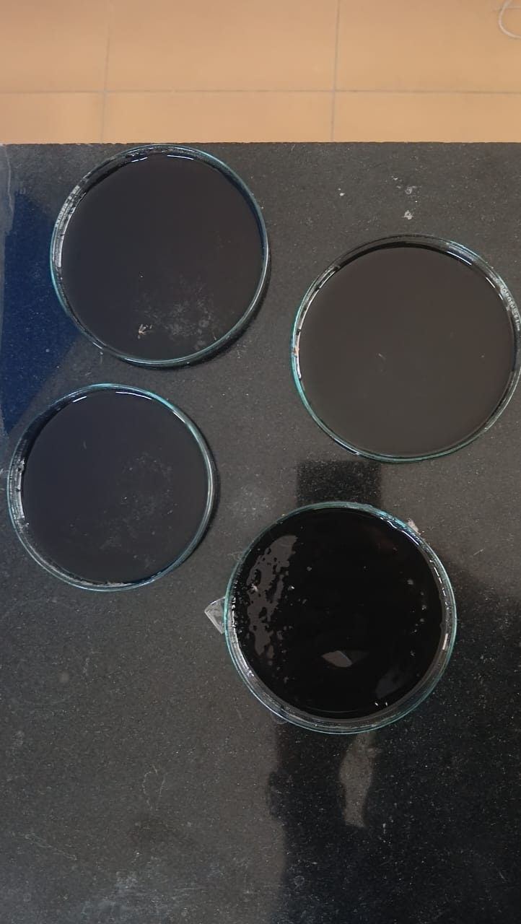
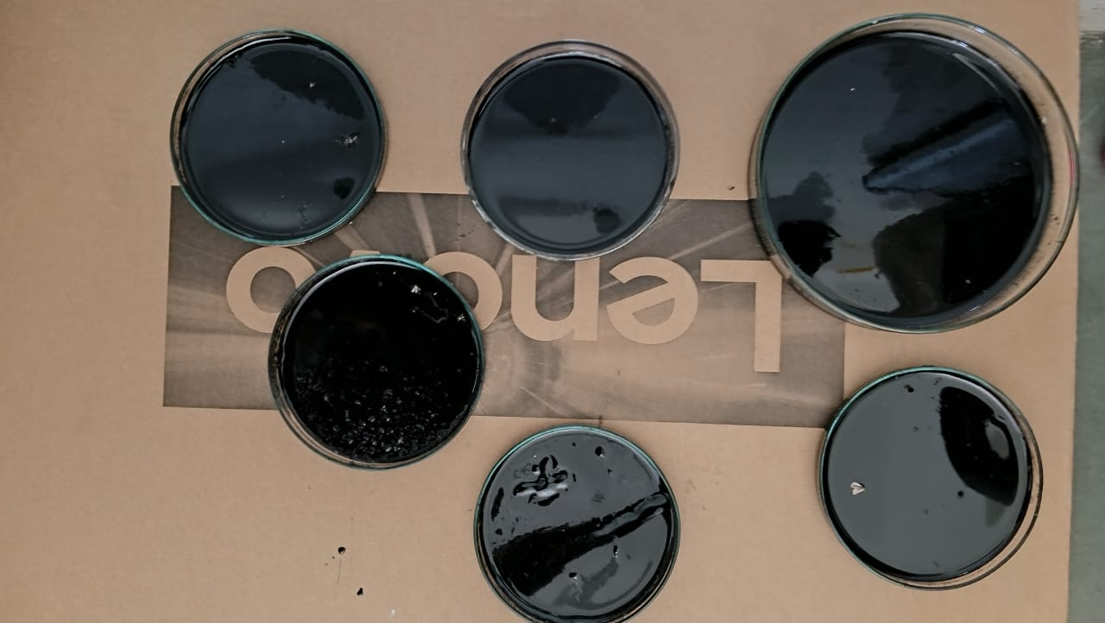
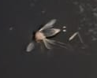
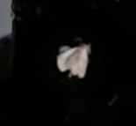
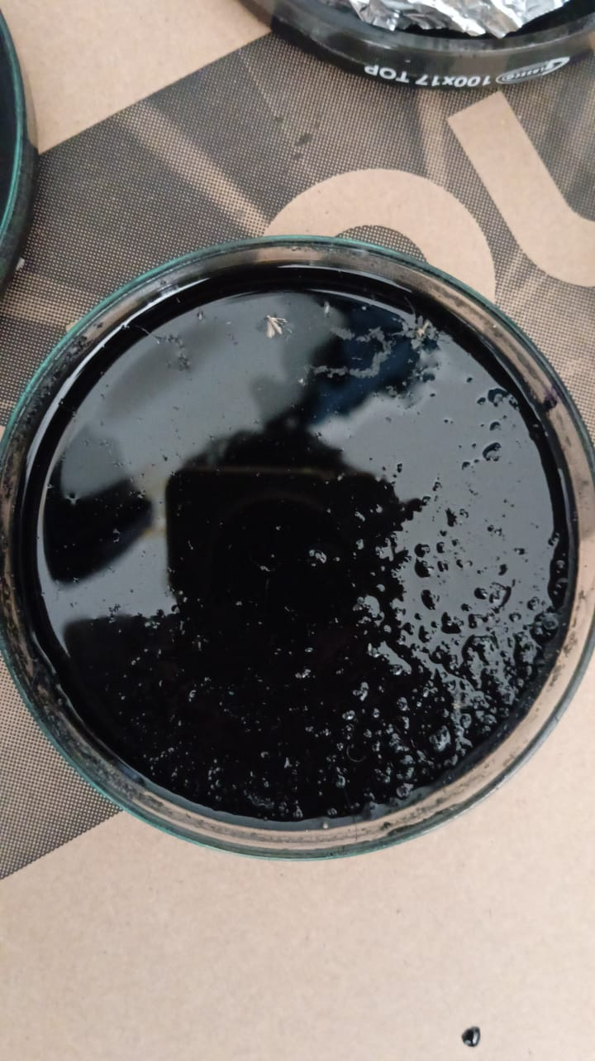
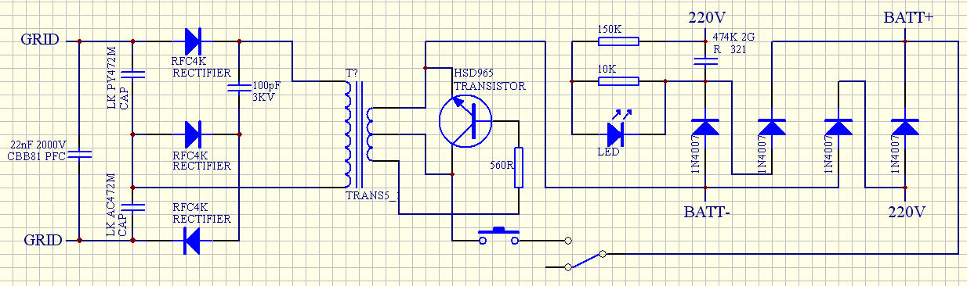
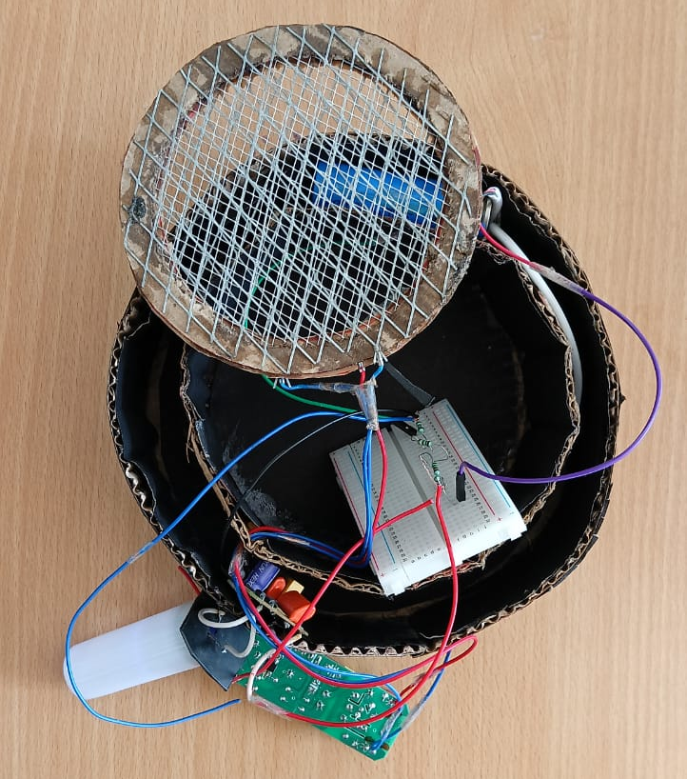
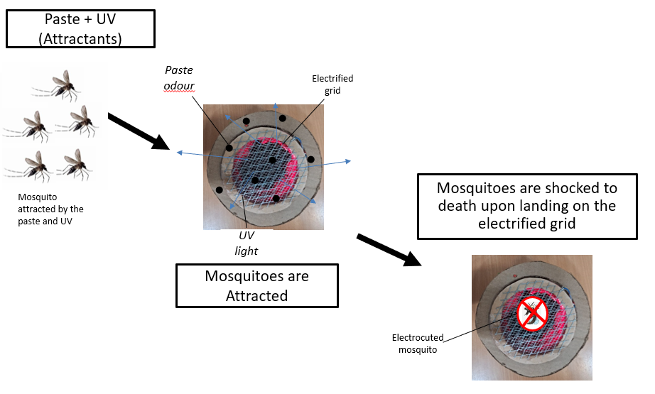
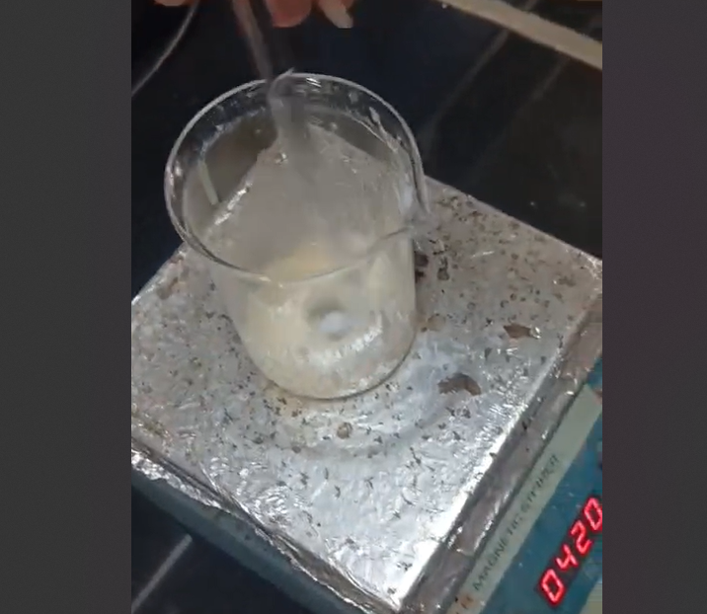
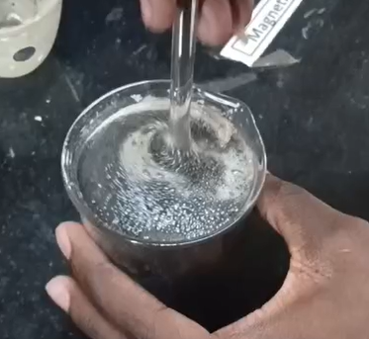
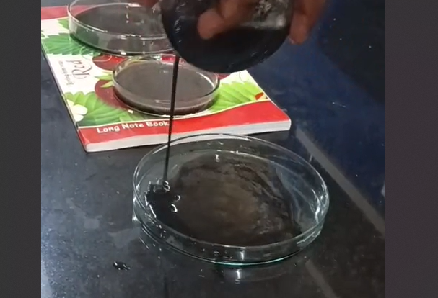
Advanced Mosquito Eradicator System
Siyamdumisa Mugari, Keerthi Kumar K J, Prince Maphosa | Dr. Jagadeeswari R | EC CH
Motivation/ Introduction
Results
Diseases spread by mosquitoes, including malaria, dengue, and Zika, remain a major global concern. Conventional control methods, such as insecticides, repellents, and zappers, not only pose risks to the environment and health but also lose effectiveness as resistance builds. This invention offers a sustainable solution by integrating biochemical and electrical techniques. A uniquely formulated paste and UV light attract mosquitoes, which are then eliminated by a high-voltage electrified grid.
The mosquito eradication system successfully lured and eliminated mosquitoes. The paste, which emitted CO₂ and VOCs, simulated human presence, attracting mosquitoes to the high-voltage grid where they were immediately electrocuted.
Key findings include:
• Improved Attraction – The combination of CO₂, natural scents, and UV light enhanced the system's ability to attract mosquitoes.
• Immediate Elimination – The high-voltage grid provided swift extermination.
• Demonstrated Reliability – Controlled tests confirmed its potential for large-scale application.
SCOPE of the Project
This project aims to develop an advanced mosquito eradication system that integrates multiple attraction methods, including the release of CO₂, ultraviolet light, and certain chemical agents, to effectively lure mosquitoes. Unlike traditional mosquito traps, this design enhances efficiency by using a sophisticated attractant paste in conjunction with a high-voltage electrocution grid. The system prioritizes safety, efficiency, and scalability, making it suitable for both indoor and outdoor use. By adopting this novel approach to mosquito control, the initiative has the potential to significantly improve public health by reducing the incidence of mosquito-borne diseases in affected regions.
Methodology
Claims
Mosquito attractant→ UV Light with electrified grid system → Electrocuted!
1. Mosquito Attraction
The attractant paste releases CO₂ and volatile compounds to mimic human scent.
KMnO₄ and carbon compounds facilitate CO₂ production.
Additional natural attractants & UV light enhance mosquito luring.
2. Mosquito Extermination
Uses a mosquito zapper circuit.
A high-voltage grid above the attraction zone eliminates mosquitoes.
Mosquito Zapper Circuit
3. Preparation of CO₂- infused paste
Start by combining a few grams of cornstarch, gelatin, sugar, glycerin, and water, stirring until the mixture thickens.
Additionally, incorporate honey, yeast, baking soda, citric acid, CO₂ powder, and KMnO4, then mix the ingredients thoroughly.
Introduce lactic acid and ethanol into the prepared mixture.
Allow the solution to sit for 4-6 hours to enhance CO₂ emission during fermentation.
Application: Strategically place the paste inside the model to effectively lure mosquitoes.
Dual-Attractant System – Utilizes CO₂, volatile compounds, and warmth to attract mosquitoes efficiently.
Integrated Extermination – Features a commercial high-voltage zapper circuit for immediate mosquito eradication.
Power Efficiency – Functions on a single power setting to ensure consistent, low-energy use.
Real-World Application – Affordable and adaptable for residential, outdoor, and high-risk environments.
Enhanced Lure Efficiency – A fermented attractant paste increases CO2 production, outperforming typical traps.
Work Flow
Prototype
Conclusion/ Summary
This model offers a practical solution for decreasing malaria-related deaths and curbing the transmission of diseases carried by mosquitoes. By combining a chemical lure with an electrocution mechanism, it effectively eliminates mosquitoes. Its affordable and scalable design makes this system an effective method for mosquito control, suitable for use in homes, public areas, and regions at high risk.
Contact Details
24ec199@kpriet.ac.in ; 24ec069@kpriet.ac.in ; 24ch067@kpriet.ac.in
Acknowledgments/ References
We thank our mentors and institution for their support, and acknowledge the resources that aided our research.
Circuit: https://i2.wp.com/www.electro-tech-online.com/imgcache/15-zapperv2.jpg?strip=all
Attractant: https://www.nea.gov.sg/corporate-functions/resources/research/environmental_health_institute/mosquito-traps/effectiveness-of-mosquito-traps?strip=all
Pictorial representation of the preparation of CO₂ infused attractant paste

